Slide 1
Malware
Oli Bills
ofb@ecs.soton.ac.uk

Slide 2
Last Time
Code review
Analysis of programs
Static analysis
Without running the program
Different forms
With the source code
With the byte code
With the machine code
Different perspectives
What can we find from the executable?

Slide 3
What’s coming up
An introduction to Malware
Types of malware
Common techniques employed
Analysing Malware
We don’t have the source code…
Static analysis
Basic static analysis: What we can learn from the outside
Advanced static analysis: Digging deeper with dissasembly
Dynamic analysis
Next week!

Slide 4
Preparing you for your lab
Your lab today will involve the following:
1) Statically analysing a selection of samples, without running them, to try to identify if they are suspicious
2) Dynamically analysing a running a set of real malware samples in a sandbox environment and observing and analysing them

Slide 5
Getting malware
It’s a lot harder than you might think!
It is actually rather hard to get infected, unless you do something stupid
Dodgy email attachments
Not keeping things up to date
Thinking that Game_Of_Thrones.mp4.exe sounds like a good idea
Clicking download buttons on websites that aren’t actually download buttons
There are good collections of malware samples out there
http://virustotal.com/intelligence

Slide 6
Exploit Kits
There are exploit kits to help deliver malware to unsuspecting visitors of websites
They bundle together exploits in commonly neglected software that users will have
Javascript in the browser
Java (that’s why it’s always updating…)
Adobe PDFs (they should have just made them dumb!)
Who uses the advanced functionality anyway?
Want to distribute some malware?
Get an exploit kit, bundle your malware, get it out
If you’re lucky, onto an advertising network

Slide 7
Exploit Kits
Maybe I’d better press Yes…
Or uninstall...

Slide 8
My honeypot
Grab a domain name
Use various emails at that domain name on various places and paste it in various public places
Set up a mail server (I used sendmail)
Set up all incoming email addresses to be piped to a script
I wrote a simple script that processes any incoming email
It then grabs any received attachments, extracts them if they’re compressed, and collects them into a folder
Now you’ve got a folder of fresh malware!

Slide 9
Types of malware
Target
Mass
Specific (e.g. Stuxnet)
Forms
Trojan Horse: Beware of Greeks…
Virus: Spreading by host file
Worm: Spreading by vulnerability

Slide 10
Types of malware
You pay the price another way…
You’d be amazed how many of the malware samples are these...

Slide 11
Types of malware
Characteristics
Information stealing
Remote access
Backdoor
Botnet
Ransomware
Rootkit
Scareware
Downloader
Launcher

Slide 12
Information Stealing
Collect information from computer and send it to the attacker
Keyloggers: Actively recording everything typed
Sniffers: Monitor for anything that looks interested
Password stealers: Grab autocomplete and password information from web browsers and send them off
Intercepting: Browser extensions, proxy or similar technologies to intercept and manipulate web traffic
Ebay, Amazon, your bank…

Slide 13
Remote Access
Backdoor
Allows an attacker remote access
Commonly a remote shell
Botnet
P2P networks, IRC, Twitter…
Listen and wait for commands
Download this
Execute this
Send data
Send a photo from the webcam...

Slide 14
Remote Access
Just don’t leave your botnet unprotected

Slide 15
Ransomware
Hold all of your important files to ransom, only once it’s too late
Silently install, and start encrypting files in the background that you’re not using
Ideally, using asymmetric encryption, so you’d never have had the key on the system
Once everything is encrypted, inform the user and demand money

Slide 16
Ransomware

Slide 17
Ransomware
The thing that amuses me?
They have support hotlines…

Slide 18
Ransomware
They are getting more clever
Sticking around for a while
Install a filter, that decrypts data on the fly unseen by the user, so their data is encrypted and they don’t realise it
Backups continue to run for a while, until it’s in all the backups
At some point in the future, the filter destroys itself along with the decryption key
Now your files and your backups are lost!

Slide 19
Scareware
Similar idea, but more removable
Scare the user into thinking they have to pay to get their computer back
Generally disable general computer operation
But we know better…

Slide 20
Scareware

Slide 21
Rootkit
Hooking into operating system calls and changing their behaviour
Conceal the payload
If you can’t see it, you can’t easily remove it
Or even know it’s there…
Common examples
File and directory hiding
Process hiding
Registry hiding
Falsified files
Preventing applications from running
Resisting removal

Slide 22
Downloaders and Launchers
Specific standalone code to bundle other malware
Downloaders/Droppers
Minimal applications whose sole goal is to download malware and execute it
Launchers
To launch other malware
Generally to make use of exploits and launch in a specific way
Bypassing UAC
Elevating to SYSTEM privileges
Other operating system exploits

Slide 23
Malware is all over the place
Windows
Primarily
Mac
Growing!
Had to clean my friends Mac for the first time!
Linux
Compromise the server, that’s a lot of resources you’ve just gained…
Android
The Play store won’t protect you…
Sideloading is even worse
A growing minefield

Slide 24
On Windows
Portable Execute format (PE)
Linking
Static: Code from library is in executable
Dynamic: Imports listed, OS loads at start
Runtime: Connect to libraries only when function needed
PE Header
Information about the entire file
Type of code
Flags (e.g. executable, DLL)
Linking information
Size and memory information

Slide 25
On Windows
PE Sections
PE file made up of sections
Sections have names, flags (e.g. executable) and content
Typical layout:
.text
Instructions – what the CPU executes
Contains the executable code
.rdata
Imports and exports
.data
Global data for the program
.rsrc
Resources used by the program (e.g. icons, dialogs, strings)

Slide 26
On Windows
PE Execution
Extract entry point, heap and stack sizes from PE header
Iterate through sections and load into virtual memory
Find address of entry point from symbol table
Load imports
Create a new thread at that address, and execute

Slide 27
Linking Information
Imports
What will be called outside
DLLs – libraries of functions that you can use
You will get used to seeing certain DLLs
Kernel32.dll – Core functionality (memory, files, hardware)
Advapi32.dll – Windows components (service manger, registry)
User32.dll - User interface components
Gdi32.dll – Display
Ntdll.dll – Interface to windows kernel
WSock32.dll/WS2_32.dll – Winsock (network)
Wininet.dll – High level networking functions
Exports
What can be called inside
Dllmain

Slide 28
Common Techniques
Persistence
Stealth
Appearing legitimate
Hiding in other processes
Packing
Obfuscation
Rootkits
Anti-analysis

Slide 29
Persistence
Malware generally needs to persist between system boots
Although becoming less important these days with “always-on” systems
How can they make sure they load each time?
Logon (Shell, Run)
Explorer hooks
Scheduled tasks
Services
Drivers
Boot execute
AppInit (DLL loaded into every application that starts)
Generally: Remove their persistence, remove the malware!

Slide 30
Persistence
There can be clever technqiues
If the malware is running
Make it hard to stop the Malware once it is running
Prevent removing/changing the persistence
Hide the presence of persistence (Rootkit behaviour)
RunOnce
Every boot, the malware is loaded from the RunOnce key, then removed – but it’s in memory
No tools will show it as being persistent anywhere, as the RunOnce key is no longer populated
On a clean shutdown, write back to the RunOnce key
Solution: Don’t clean shutdown!

Slide 31
Stealth
Camouflage against legitimate system files
Check digital signatures
Pretend to be Microsoft
Call your things stupid names, like KB138719.exe as a Windows update and put it in the updates folder… Nobody will ever suspect!
Inject into other processes
Nobody would ever expect explorer.exe
Replace legitimate files
Legitimate + a little bit extra
Hiding from the operating system
Rootkit time!
Replace things that don’t get used often
Goodbye calculator... Until next time!
How would you hide?

Slide 32
Packing and Obfuscation
Take an application, then pack it inside a wrapper application
When the application is run, the inner application is unpacked into memory and executed
When you try to inspect the application, you only see the wrapper
Makes static analysis harder
Can’t look at the application and work out what it does
But ultimately, it needs to be unpacked at some point…

Slide 33
Malware Analysis
Basic analysis
Basic static analysis
Analysing without running
Does it look suspicious?
What should it do?
Basic dynamic analysis
Analysing it in it’s natural habitat
What does it do?
Advanced analysis
Advanced static analysis
Reverse engineering the code
Advanced dynamic analysis
Real-time debugging

Slide 34
Anti-analysis
Detect the presence of Virtualization
Behave differently
Don’t behave at all!
But how does it work?
Look at the drivers
Look at the virtualized devices
Look for the virtualization support software
Look for analysis tools
Networking
Look for any other signs (low RAM, low hard drive size etc.)
What do they often do?
Self destruct!
Certain packers/wrappers – e.g. VMDetect
Make it easy for people to protect their malware against detection
However, make it easier for people to try to bypass a standard set of code

Slide 35
Basic Static Analysis
Examine the PE file itself
Signature: What was it compiled with?
Structure: Is it packed?
Sections: How is the file made up?
Metadata: What other information is there?
Certification: Has the file been digitally signed?
Imports: What does it use?
Exports: What does it make available?
Strings: What text does it contain?
Resources: What icons, menus, dialogs does it have?

Slide 36
Signature and Structure: Detect it Easy
Helps you before you try to do static analysis
For example, working out how to unpack it, if you can
Uses signatures for PE information
Various PEInfo tools
Work out what an application is packed with
Work out what an application was compiled with
Other information about the application

Slide 37
Examining the PE File
The Portable Executable (PE) file format is used by Windows executables, object code, and DLLs
The PE file format is a data structure that contains the information necessary for the Windows OS loader to manage the wrapped executable code
The information in the PE can provide valuable information to the malware analyst
Use DependencyWalker and Peview to examine a PE file

Slide 38
PE File Structure
Header
stores information about every library that will be loaded and every function that will be used by the program
Sections
.text Contains the executable code
.rdata Holds read-only data that is globally accessible within the program
.data Stores global data accessed throughout the program
.rsrc Stores resources needed by the executable

Slide 39
PE File Header
Field | Information Revealed
Import | Functions from other libraries that are used by the malware
Export | Functions in the malware that are meant to be called by other programs or libraries
Time Data Stamp | Time when the program was compiled
Sections | Names of sections in the file and their sizes on disk and in memory
Subsystem | Indicates whether the program is a command-line or GUI application
Resources | Strings, icons, menus, and other information included in the file

Slide 40
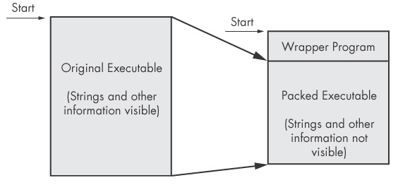
Packing and Obfuscation
Is it packed?
Barely any imports
No useful strings
Non-standard names of sections
Section specifications
Section contains code
Section can be executed as code
Size differences
Two main functions
LoadLibrary
GetProcAddress
Other functions
Functions which work with virtual memory
Functions to work with libraries
Is it obfuscated?
No useful names
Conventions not adhered to
No useful strings

Slide 41
If it is packed…
You’ll want to unpack it first before doing analysis!
Various different packers
Some can be easily unpacked
UPX: Automatic pack and unpack utility
Some are harder to unpack
Manually extract the inner application
Follow the tail jump
Some are nearly impossible to unpack
Attempt to dump the process from memory

Slide 42
Sections and Metadata PEStudio
Allows us to see what sections an executable has
Allows us to take a peek inside
Gives lots of other very useful information!
Inspects the PE and information inside, including strings and imports and exports
Tells you if there’s anything that is likely to be suspicious
Helps filter out the legitimate from the illegitimate
Easier to determine if something is suspicious!

Slide 43
Metadata and Certification
Has the file got version information?
Has the file been digitally signed?
Common indicators as to whether it is legitimate!

Slide 44
Imports and Exports: Dependency Walker
Imports: What functions does the malware use
Only includes those directly accessed
Exports: What functions does the malware make available – when the malware isn’t a single file
But they probably won’t be helpfully named
Dependency walker breaks this down for us
You’ll get to know the libraries and functions after a while!

Slide 45
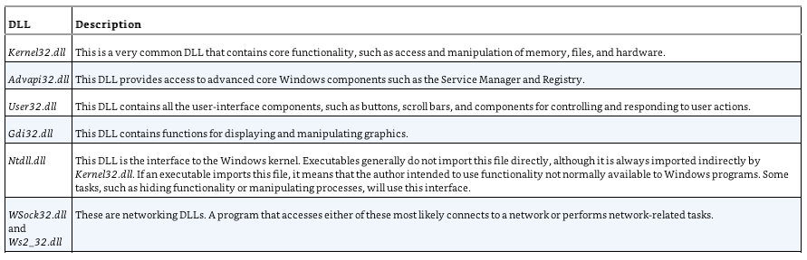
Common DLLs

Slide 46
Examples of Imported functions
OpenProcess, GetCurrentProcess, and GetProcessHeap
open and manipulate processes
ReadFile, CreateFile, and WriteFile
open and manipulate files
FindFirstFile and FindNextFile
search through directories

Slide 47
Strings
Simple tool – find all the strings that are accessible in the file
Tells you functions that it calls
Tells you domains that it tries to connect to
Tells you information that may be displayed in the UI
Sometimes contains fun messages from the malware authors!

Slide 48
Resources Resource Hacker
View the sections inside the application
View the resources that are associated with it
Inspect any images, icons, dialogs and other resources inside
If the application has a GUI, gives you an idea as to what it does!
Does it look legitimate?

Slide 49
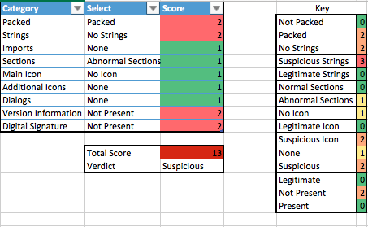
Is it suspicious?

Slide 50
Advanced Static Analysis
So far
Whether it looks suspicious, what it could be doing
The next steps
What it is doing, in what order, and how and when
Taking the malware on the disk in binary form and disassembling it into assembly code
We can then explore the assembly code to learn what it is doing
All still without running it!
The only real tool for the job: IDA

Slide 51
Analysts Assemble!
Just like with the later examples we looked at, we don’t have the source code here
We have to work with the assembly instructions
The “human readable” version of machine code
Low level
Registers, memory, CPU instructions
It’s not easy!
But we don’t need to understand everything, just the bits that are most interesting to us
Know when to give up!

Slide 52
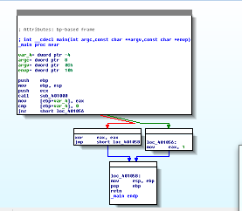
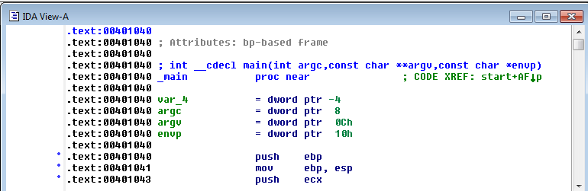
Graph and Text Mode
Spacebar switches mode

Slide 53
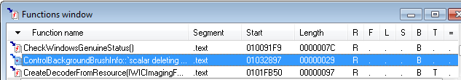
Functions
Shows each function, length, and flags
L = Library functions
Sortable
Large functions usually more important

Slide 54
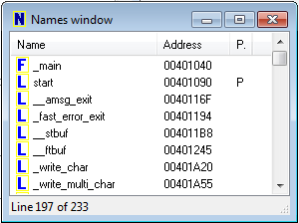
Names Window
Every address with a name
Functions, named code, named data, strings

Slide 55
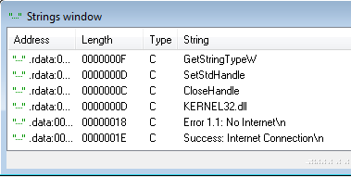
Strings

Slide 56
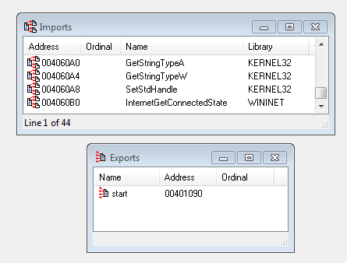
Imports & Exports

Slide 57
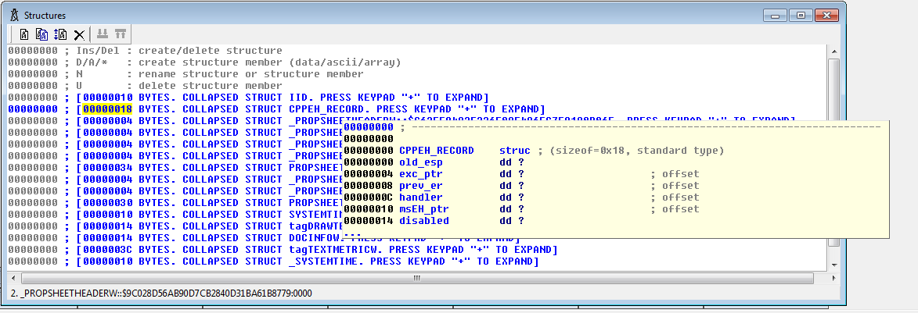
Structures
All active data structures
Hover to see yellow pop-up window

Slide 58
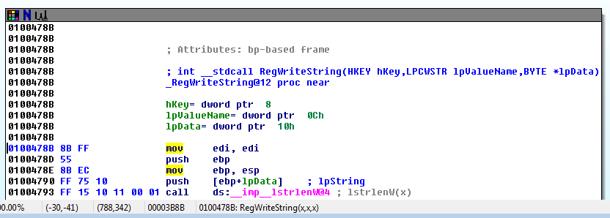
Function Call
Parameters pushed onto stack
CALL to start function

Slide 59
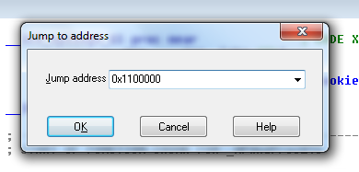
Jump to Location
Press G
Can jump to address or named location

Slide 60
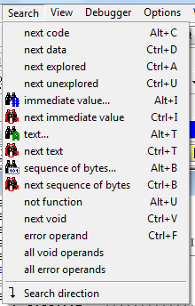
Searching
Many options
Search, Text is handy

Slide 61
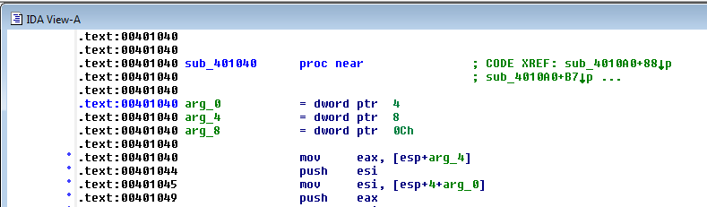
Function and Argument Recognition
IDA Pro identifies a function, names it, and also names the local variables
It's not always correct

Slide 62
Advanced Analysis
Feel free to have a play already
You are only looking to see if you can spot anything interesting, you’re not trying to reverse engineer the whole thing
Look up strings and function calls and see if there is any interesting code around it
For UPX packed binaries, you’ll need to unpack them first
Don’t worry about reverse engineering other packed binaries!
We will be covering this in more detail in the next tutorial on Thursday at 10:00

Slide 63
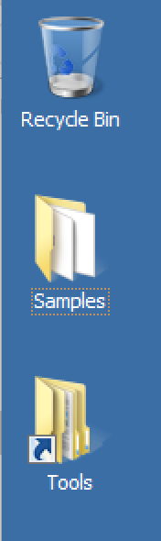
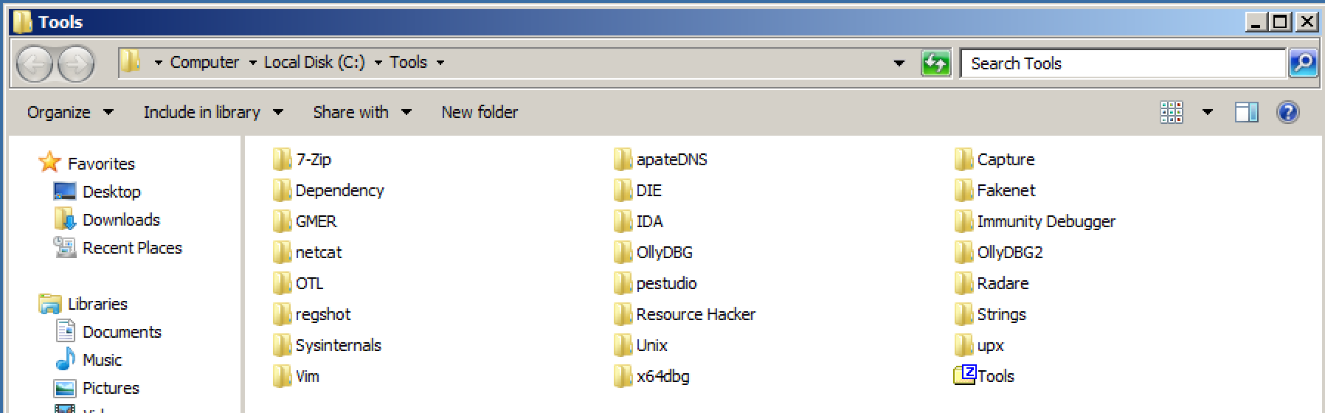
All the Tools
All the tools we have covered here today are freely available
They are also all installed on your Virtual Machine ready and waiting
You can find them all in the ‘Tools’ folder on the C: drive, or click the Tools shortcut on the desktop

Slide 64
Reading Materials
Michael Sikorski and Andrew Honig. Practical Malware Analysis. The Hands-On Guide to Dissecting Malicious Software. Chapters 4, 5, 7,8, 9
IDA Pro
https://www.hex-rays.com/products/ida/
OllyDbg
http://www.ollydbg.de/

Slide 65
This Lab
Your task this week, starting today
Download the Virtual Machine and get started
Look at the 10 samples using the tools we have discussed
For each sample, determine if they appear suspicious or legitimate
Consider every aspect you are able to
Where possible, use IDA to see if there is anything interesting you are able to determine about how the malware works
Write down your method and your justifications for each sample
Read the full specification on the notes page

Slide 66
Is it suspicious? What do we look at…
Imports
Icons
Strings
Advanced static analysis
Sections
Dialogs
Size
Name
Version
Digital Signatures
MD5
The assembly code itself

Slide 67
Your Task
Write a report covering what you have done
For each sample
1) Write what static analysis you did and what you found
2) Write what reverse engineering you did and what you found
3) Write what dynamic analysis you did and what you found
4) Produce a summary table of all 10 vulnerabilities with your conclusions and what you found
Note: Your final report must be a zip containing an HTML file and all the associated images (you can export this from Word)

